Slide 1
Lesson 4 The Quadratic Formula

Slide 2
i)Quadratic Func. in Standard Form: (A,B,C)
Most quadratic functions are written in standard form
We know that it’s quadratic because the largest exponent of “x” is 2
The letters “a”, “b”, and “c” are coefficients [real numbers]
The constant “c” is the Y-intercept because….
33
If “x” is equal to zero, then y = c
The coefficient “a” indicates which way the graph opens
y
y
x
4
-1
0
1
2
3
4
5
6
7
3
-1
2
-2
1
-3
At the Y-intercept, the x-value is zero
Plug “x” in and solve for “y”
-1
0
1
2
3
4
5
6
7
x
-4

Slide 3
Practice: Find the coefficients “a,b,c”, Y-intercept, and which way the graph opens

Slide 4
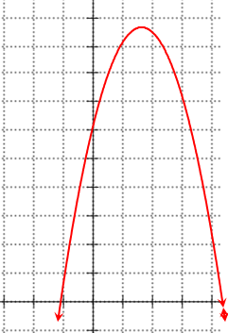
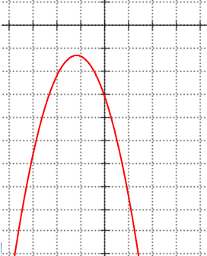
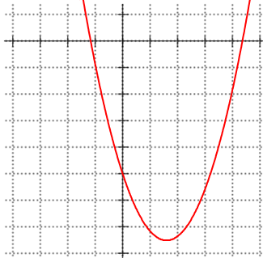
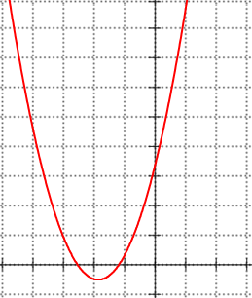
Given each equation match it with the corresponding graph:
a<0
a<0
C>0
C<0
a>0
a>0
C<0
C>0

Slide 5
II) Quadratic Formula:
When Solving a quadratic function , we can use the Quadratic formula to solve for the “x” variable:
Can’t Divide by zero!
Can’t square root a negative number

Slide 6
The QF can be used to find the “roots” (x-intercepts) without a graphing calculator
Can be used with equations that can not be factored
Ex: Solve for “x”
First: Find coefficients
Plug coefficients into formula:
You get two answers because of +

Slide 7
Ex: Solve for “x” to 2 decimal places
First: Find coefficients
Plug coefficients into formula:

Slide 8
Conditions for Using QF:
One side of the equation must be zero! (Move all numbers to one side)
Equation must be a Quadratic Function and in “General Form”
IF is negative, then you will have “NO Real Solutions”! (NO answer)

Slide 9
Ex: Solve for “x”
No Real Solutions!

Slide 10
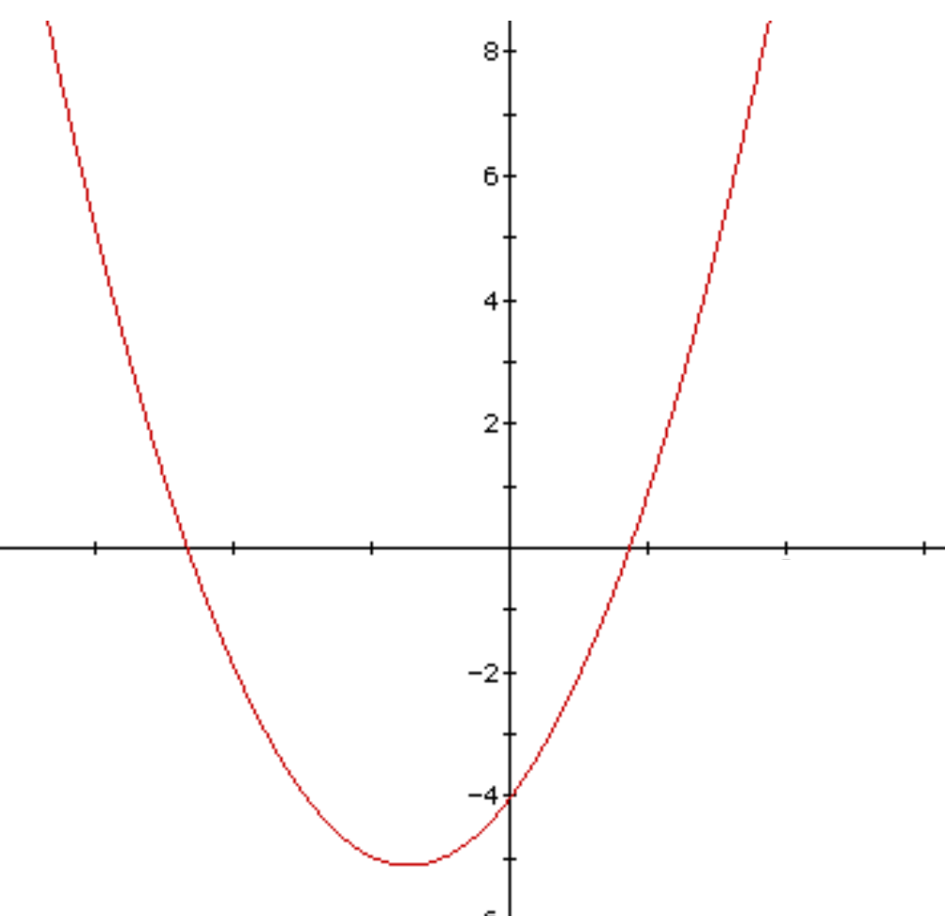
Using the Quadratic Formula to Find the Vertex:
Key Ideas: The quadratic function gives you the two x-intercepts
The vertex is in the middle of the two x-intercepts
Goal: How do you find the middle?
SO, what does this mean???!!
You don’t need to factor to find the middle anymore. The middle will be at:
Let see what happens when you average out these two X-intercepts
Find the coefficients “a” and “b” and then plug it into the formula!
This will give you the x-coordinate of the vertex!

Slide 11
Ex: Given the equations below, Equation of the Axis of symmetry, and coordinates of the vertex:

Slide 12
A rock is thrown into the air. The height of the rock is given by the formula: where “h” is the height in meters and “t” is the time after the rock is thrown in seconds.
When does the rock reach the maximum height?
What is the maximum height that the rock reaches?
When does the rock hit the ground after it is thrown?
9
8
7
6
5
4
3
2
1
0
To find out when the rock hits the max height, use the formula:
To get the maximum height, plug t=2.38s into the formula for the height
TIME (s)
2
3
4
5
6
7
8
9
1
9
0
© Copyright all rights reserved to Homework depot: www.BCMath.ca

Slide 13
A rock is thrown into the air. The height of the rock is given by the formula: where “h” is the height in meters and “t” is the time after the rock is thrown in seconds. How long will it take the rock to hit the ground?
When the rock hits the ground, the height will be 0 meters high
Now use the Quadratic Formula
to solve for the time “t” needed to
hit the ground
9
8
7
6
5
4
3
2
1
0
TIME (s)
2
3
4
5
6
7
8
9
1
9
0
It took approximately 4.9 seconds
for the rock to hit the ground
© Copyright all rights reserved to Homework depot: www.BCMath.ca

Slide 14
A tank is parked next to a cliff and fires a missile. The height of the missile is given by the formula: The missile is to be detonated when it is falling at 80m above the ground. After how many seconds should the missile be detonated after it is fired?
The missile is detonated when it falls to a height of 80m
Make equation equal
to zero and then use the quadratic formula
9
8
7
6
5
4
3
2
1
0
TIME (s)
1
0
1
2
3
2
3
4
5
6
7
8
9
1
9
0
0
Time while going up
It took approximately 9.15s
for the missile to fall to 80m
© Copyright all rights reserved to Homework depot: www.BCMath.ca

Slide 15
III) Where does the QF come From?
Take the equation: and Complete the Square. Then Isolate “x”

Slide 16
